Slide 1
Tie strength, role relations, and social support in ego networks
Omar Lizardo
University of California, Los Angeles
olizardo@soc.ucla.edu
The Mitchell Centre for Social Network Analysis Seminar Series
University of Manchester, Department of Sociology
June 13th 2018

Slide 2
Properties of social ties
Dyadic ties (edges, links) are the building blocks of networks
Most social network theories are built on properties of ties (Kitts 2014)
How many different ways can two people be connected?
Two people can be connected by one-way (asymmetric) tie or two-way (non-symmetric) ties
If the links are thought of as conduits via which some things “flow” then people can be connected by one-way flow links (non-reciprocal) or two-way flow ties (reciprocal)
People can be connected via more than one type of tie (multiplexity) or a single type of tie (uniplexitiy)
People can be connected via fleeting, emotionally distant (weak) ties or via durable, sturdy, emotionally close, frequently activated, hard to break (strong) ties

Slide 3
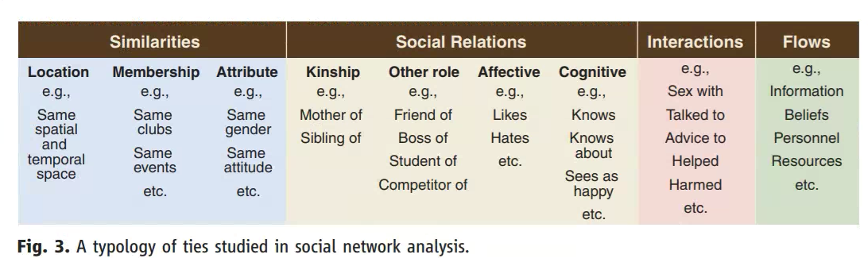
How many types of social ties are there?
Borgatti, S. P., Mehra, A., Brass, D. J., & Labianca, G. (2009). Network analysis in the social sciences. Science, 323(5916), 892-895.

Slide 4
How many types of social ties are there?
Role relations (states)
Friends, kin, business partners
Interpersonal sentiments and cognitions
Liking, trusting, acquaintanceship
Behavioral Social Interactions
Calling, texting, citing, supporting, resource exchange
Opportunity structure for exchange
Structural holes, brokerage, intermediation
“Non-ties” matter here
Kitts, J. A. (2014). Beyond networks in structural theories of exchange: Promises from computational social science. In Advances in Group Processes (pp. 263-298).

Slide 5
Types of ties (combined)
Social Ties
Relationships
Interactions
Similarities
Role Relations
Sentiments
Communication
Exchanges

Slide 6
Tie properties: Strength
Tie strength is defined as a combination of multiple tie properties:
Duration
Time spent together (Similarities)
Emotional intensity (Sentiment)
Intimacy and confiding (Exchanges)
Frequency of interaction (Communication)
MIxes together frequency, sentiment, communication, and exchange criteria
KItts (2014)
Which ones are the best indicators of tie strength empirically?
“The strength of a tie is a (probably linear) combination of the amount of time, the emotional intensity, the intimacy (mutual confiding) and the reciprocal services which characterize the tie” (Granovetter 1973: 1361)

Slide 7
How do you measure tie strength?
Problems with attempts at measuring tie strength:
Some mix together role-relation and sentiment criteria
E.g. “Close Friends”
Some (even worse) use role-relations criteria to define tie strength
E.g. Kin and Friends are strong ties, acquaintances, co-workers, and neighbors are weak ties
Problem: You can be weakly connected some relatives and strongly connected to some co-workers
Others use purely frequency based criteria (who you hang out with most often)
Problem: You can be weakly connected to people you see frequently
Others use the number of kinds of relations connecting people
“Multiplex” ties are strong
Problem: some multiplex relations can be weak

Slide 8
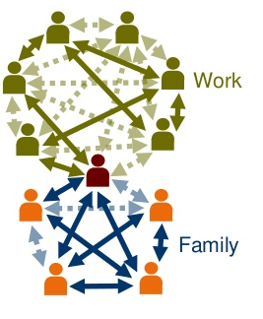
How do you measure tie strength?
Other approaches:
Duration of the relationship?
Provision and exchange of services and support?
Socio-demographic similarity?
Overlap in common memberships?
We can imagine having strong and weak ties within each of these categories
Need to compare multiple indicators against suitable criteria

Slide 9
Marsden and Campbell’s model
Predictors
Distinguish between indicators of tie strength and predictors of tie strength
Indicators:
Closeness/Intimacy (Sentiments)
Frequency (Interaction)
Duration
Exchange/Support (Exchange)
Predictors:
Role relations (Friend, Co-worker)
Common memberships and Social Position (Similarities)
Role Relations
Similarities
Tie Strength
Sentiment
Interaction
Exchange
Indicators

Slide 10
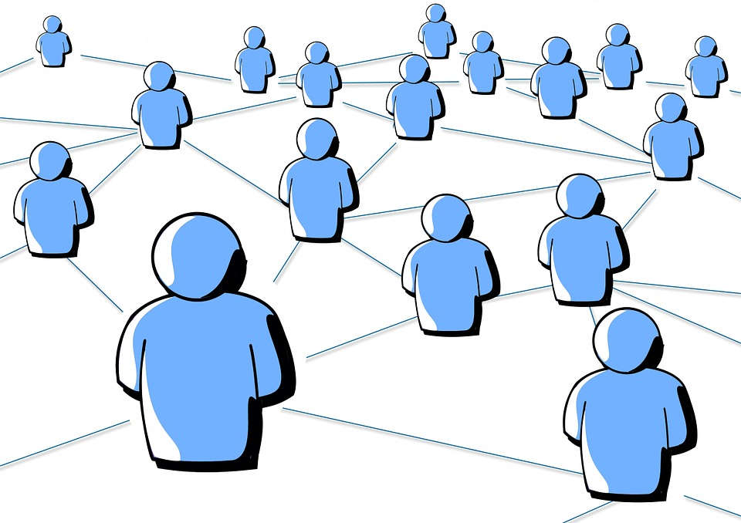
Moving forward
Ultimately relationship between indicators and predictors of strength an empirical not definitional issue
Same for relationship between different ways of being connected:
Role relations
Interactions
Support/Exchange
Cognitive
Affective/Sentiments

Slide 11
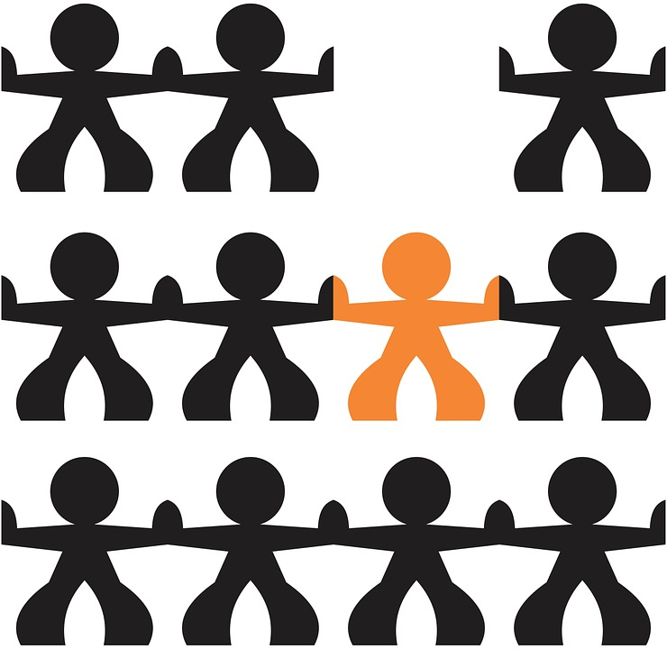
Research Questions
Association among the various measures of tie strength
Affective (closeness), frequency, duration, cognitive (salience)
Association between strength and role relations
Do role relations have specifiable tie strength profiles?
Role type, strength and exchanges
Does support come from strong ties?
Do role relations have specifiable support profiles?

Slide 12
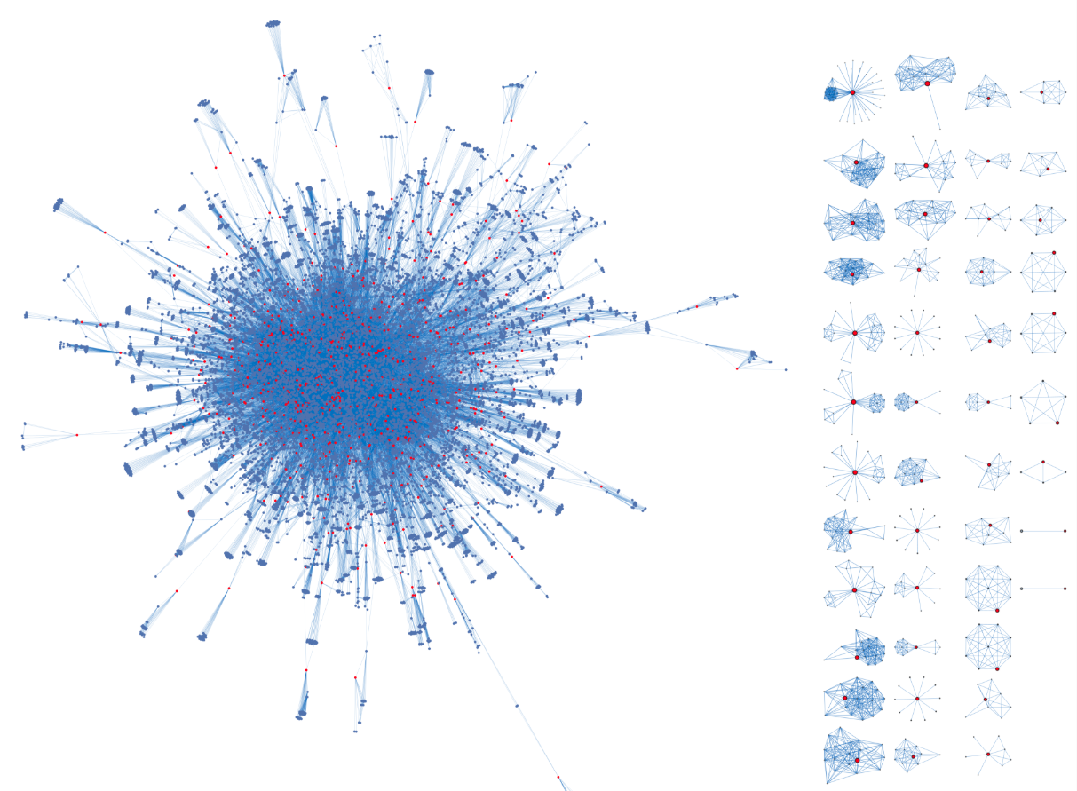
NetHealth Study
Nethealth merged ego-networks, Aug 2015 - Dec 2017
2-year NIH funded longitudinal study of ～700 first-year students who entered the University of Notre Dame in the Fall of 2015

Slide 13
NetHealth Study
Nethealth merged ego-networks, Aug 2015 - Dec 2017
3 Tiers of Students
Tier 1 - 400 students recruited in Summer 2015
Tier 2 - 100 students referred by Tier 1 students, Fall 2015
Tier 3 - 300 students recruited Winter 2015 (second semester)

Slide 14
NetHealth Ego Network Data
8 surveys issued between August 2015 and May 2018
Tracked as 7 survey waves
Plus the separate initial survey issued to Tier 2 and 3 participants at the culmination of the Tier 3 recruiting period in Spring 2016.
TABLE 1. NETSURVEY WAVES AND DATES
 | Wave 1 | Wave 2 | Tier 3 | Wave 3 | Wave 4 | Wave 5 | Wave 6 | Wave 7
Earliest Response | 03 AUG 2015 | 15 FEB 2016 | 20 MAR 2016 | 20 JUN 2016 | 01 NOV 2016 | 10 APR 2017 | 09 NOV 2017 | 26 APR 2018
Latest Response | 08 NOV 2015 | 25 FEB 2016 | 13 APR 2016 | 06 JUL 2016 | 09 DEC 2016 | 01 MAY 2017 | 05 DEC 2017 | 08 MAY 2018
Participant Tiers | 1 & 2 | 1 & 2 | 2 & 3 | 1, 2, & 3 | 1, 2, & 3 | 1, 2, & 3 | 1, 2, & 3 | 1, 2, & 3

Slide 15
NetHealth Ego Network Data
8 surveys issued between August 2015 and May 2018
Tracked as 7 survey waves
Plus the separate initial survey issued to Tier 2 and 3 participants at the culmination of the Tier 3 recruiting period in Spring 2016.
TABLE 1. NETSURVEY WAVES AND DATES
 | Wave 1 | Wave 2 | Tier 3 | Wave 3 | Wave 4 | Wave 5 | Wave 6 | Total
Ego-Alter Records | 6,743 | 5,051 | 2,986 | 4,940 | 4,303 | 3,899 | 3,212 | 31,134
Respondents (Egos) | 490 | 402 | 212 | 400 | 382 | 351 | 302 | 709
Mean Records per Ego | 13.8 | 12.6 | 14.0 | 12.4 | 11.3 | 11.1 | 10.6 | 43.9

Slide 16
Ego Network Surveys
Nethealth merged ego-networks, Aug 2015 - Dec 2017
Name generator:
We would like to know who you consider to be in your social network.
In the spaces below please list up to 20 people with whom you spend time communicating or interacting.
Kitts (2014)

Slide 17
Network Surveys
Nethealth merged ego-networks, Aug 2015 - Dec 2017
Name interpreter:
Closeness
Frequency
Duration
Role Relation
Exchanges
Alter demographics
Notre Dame contact
Same Dormitory

Slide 18
Measures
Tie Strength
Emotional Closeness
Especially close, close, less than close, distant)
Marsden and Campbell (1984)
Reported frequency of interaction
Daily, weekly, monthly, less than monthly over last 3 months)
Cognitive Salience
Integer for named order, i.e. first, second, third person named)
Duration
How long ego has known alter
Objective Frequency
N. of days per week ego texted or was texted by alter over last 3 months

Slide 19
Measures
Nethealth merged ego-networks, Aug 2015 - Dec 2017
Role Relations
Family
Friends
Romantic Partner
Acquaintances
Other (neighbor, coworker, co-member)

Slide 20
Measures
Nethealth merged ego-networks, Aug 2015 - Dec 2017
Exchanges (support)
Financial
Comfort
Hang out
Advice
A priori derived combinations of these

Slide 21
Other information
Nethealth merged ego-networks, Aug 2015 - Dec 2017
Ego demographics
Gender
Race,
Religion
ND student
Other dyadic measures
Perceived similarity
Common activities
Feld (1982)

Slide 22

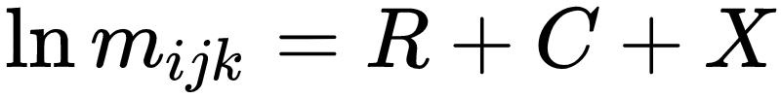
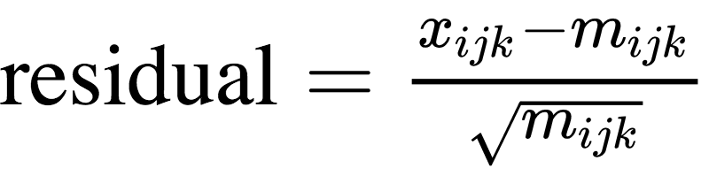
Log-linear Models

Slide 23
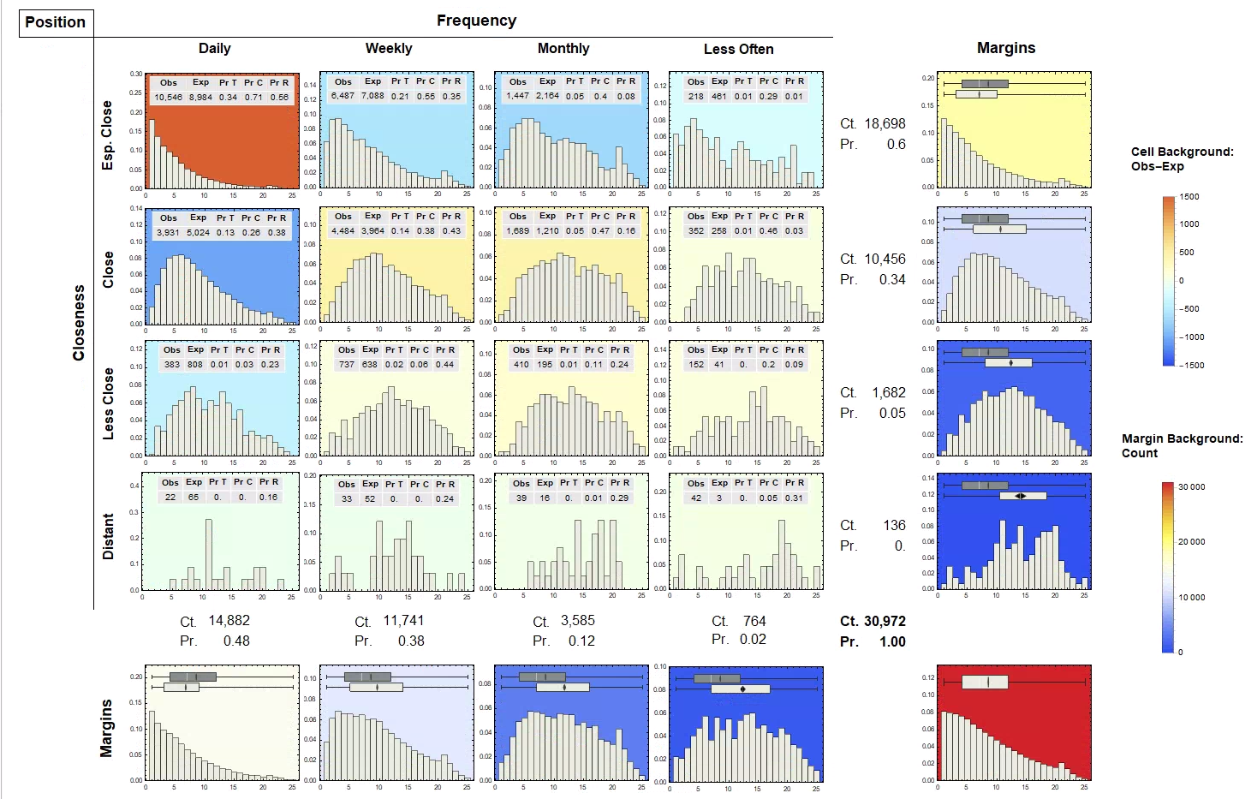
Notes:
Overall Distribution
Marginal Distributions
Less Close → Less Frequent
Lower Position → Less Frequent
Joint Distributions
Three - way association
Compare row (column) to marginal distributions
No 3-way association
Summary
F*C
F*P
C*P

Slide 24
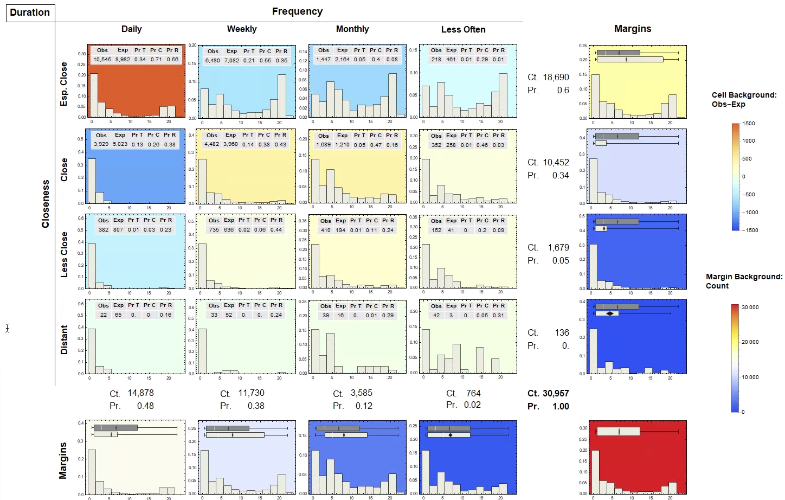

Slide 25
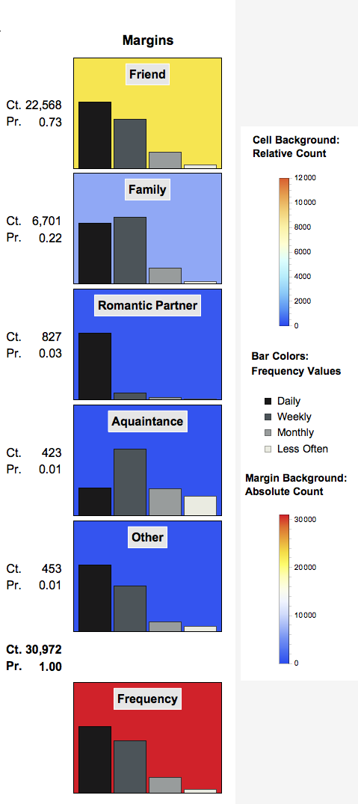
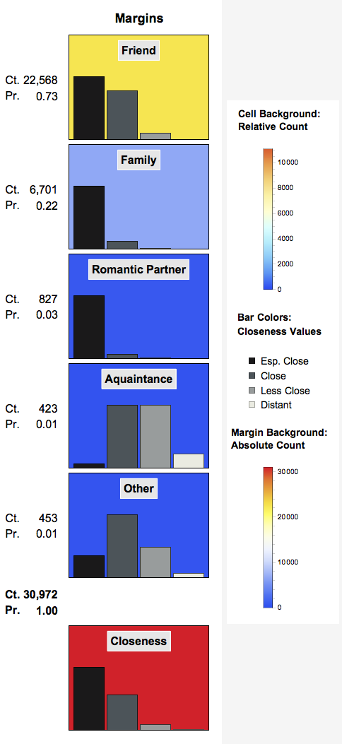
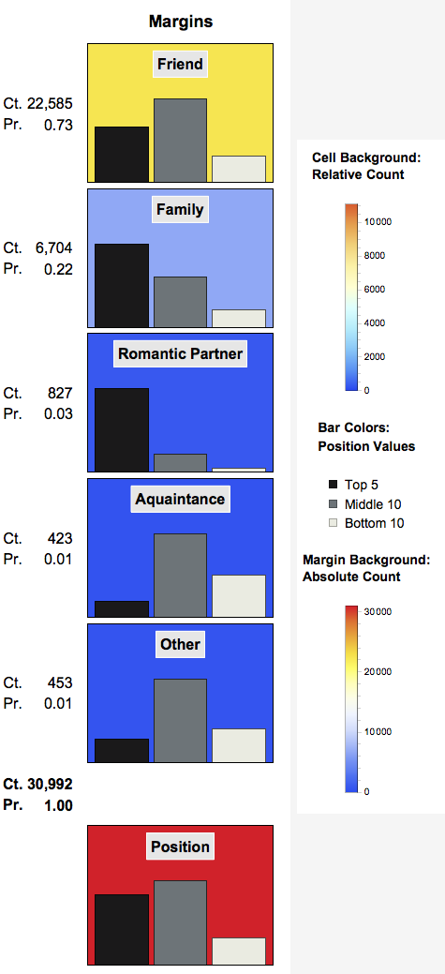

Slide 26
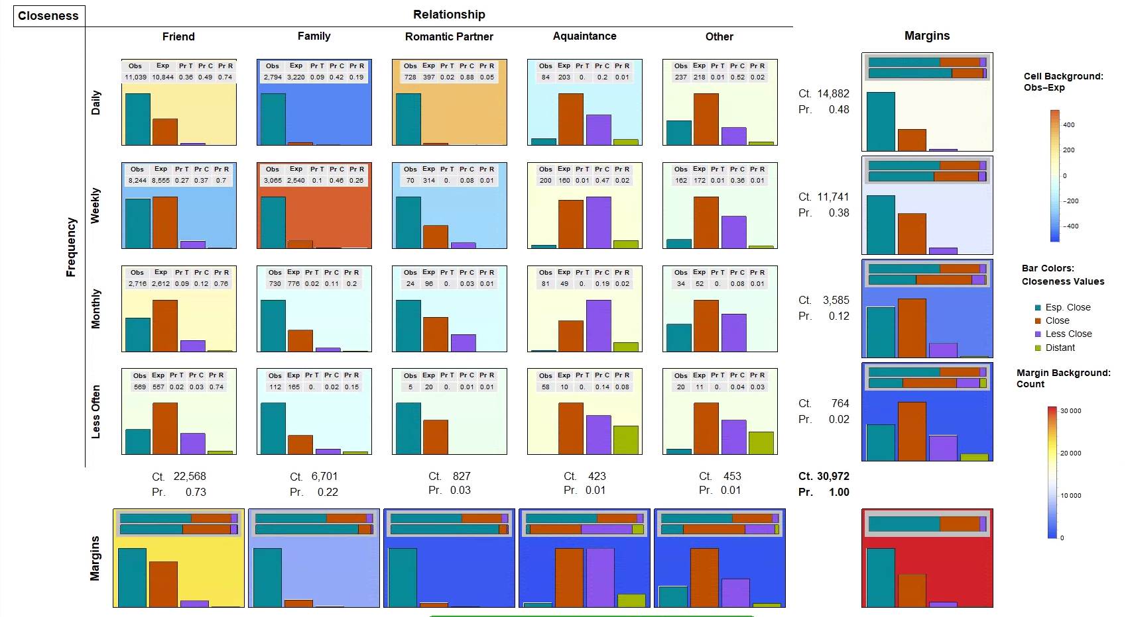

Slide 27
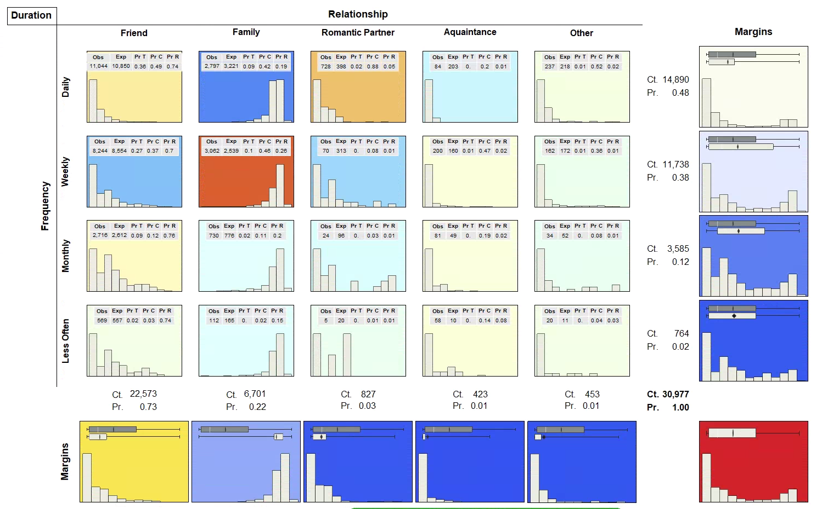

Slide 28
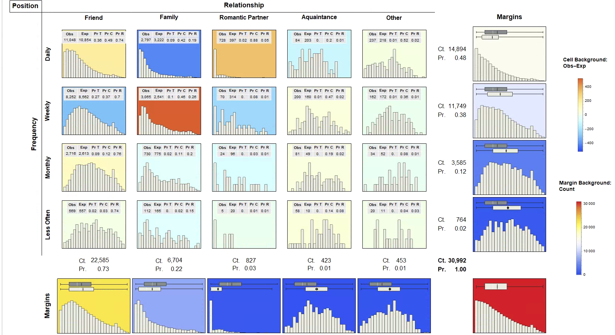

Slide 29
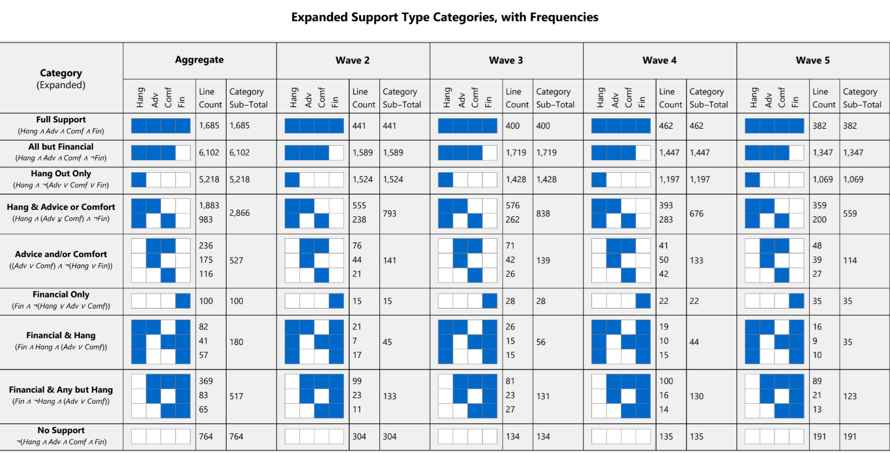

Slide 30
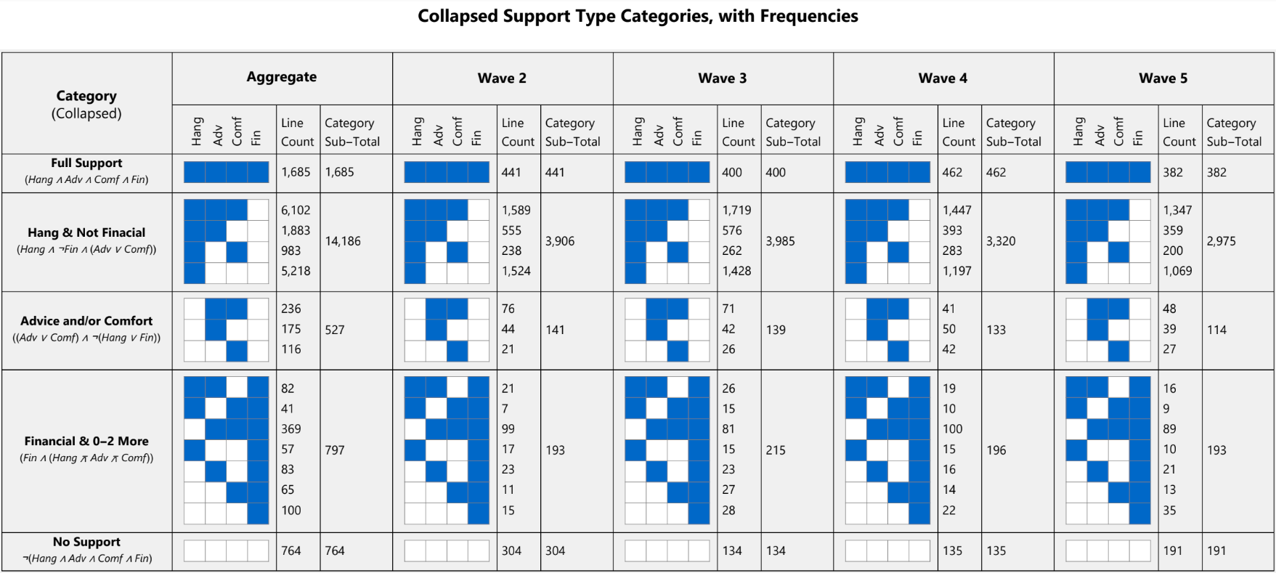

Slide 31
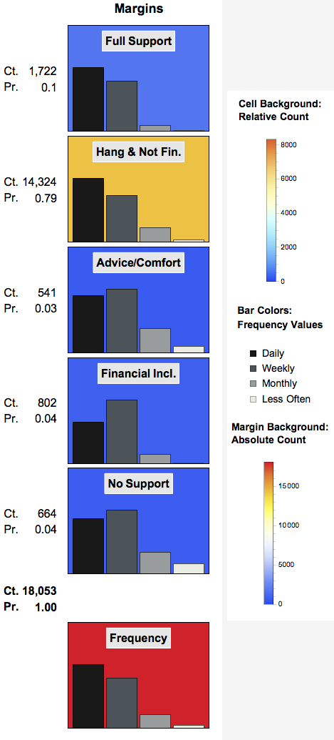
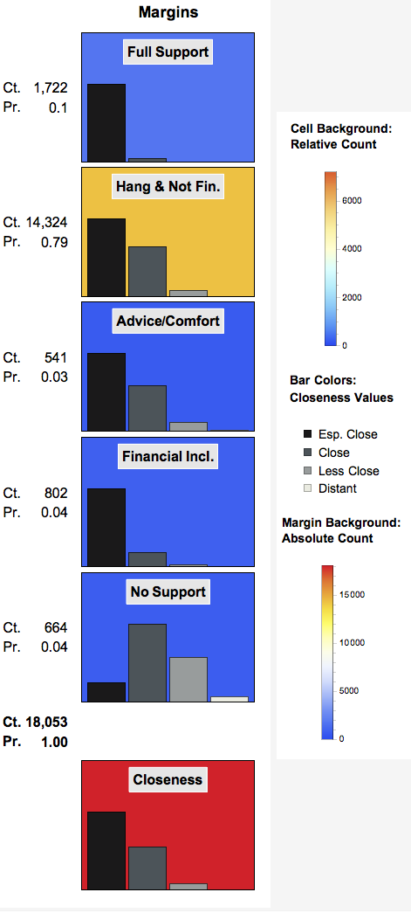
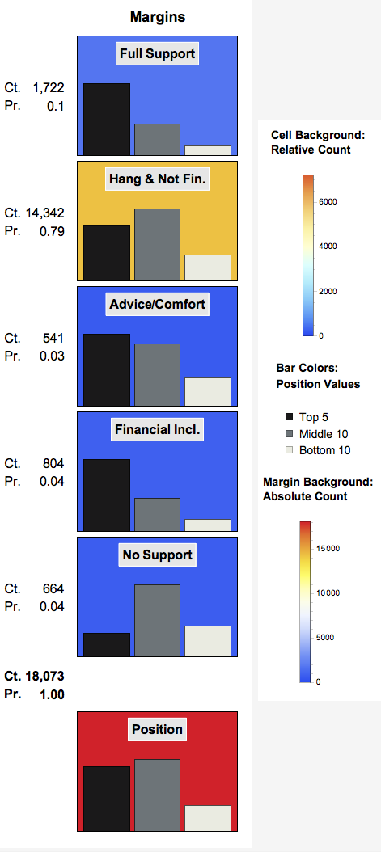
Support & Tie Strength
Notes:
Full Support
Daily, weekly, not others
Esp. Close *, not others
Top 5
Financial Support
Weekly
Esp. Close, not Close
Top 5
Social Support (Hanging out)
Daily
Close, not other categories
Bottom 10

Slide 32
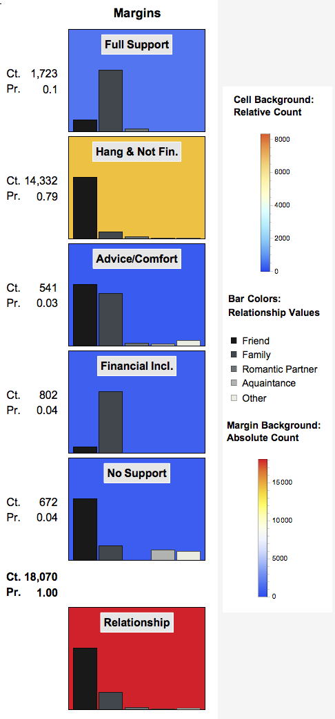
Role & Support
Full Support & Financial Support
Family, not friends
Social Support
Not family
Friends
Not acquaintances
Advice/Comfort
Family
Acquaintances (small N)
No support
Acquaintances & Other

Slide 33
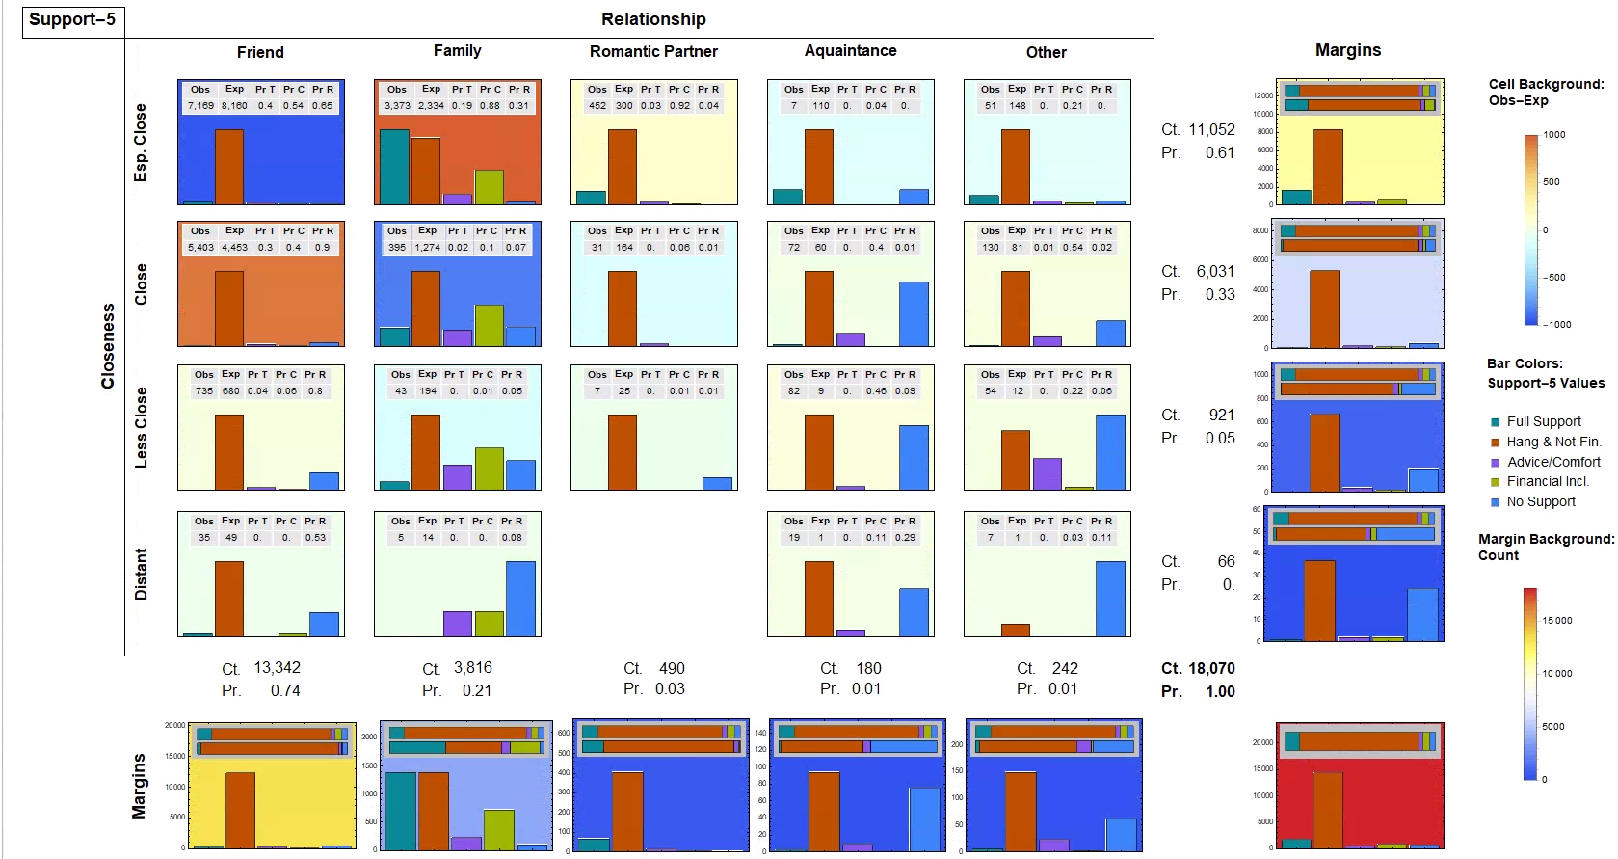
Notes:
Esp Close Friends: Not financial
Close or less close friends: hang out
Esp. Close Family: Financial and all types
Close Family: Financial
Partner
Esp. Close → all types
Close or less → hang
Acquaintance
Not close & no support
But if close or less → advice/comfort

Slide 34
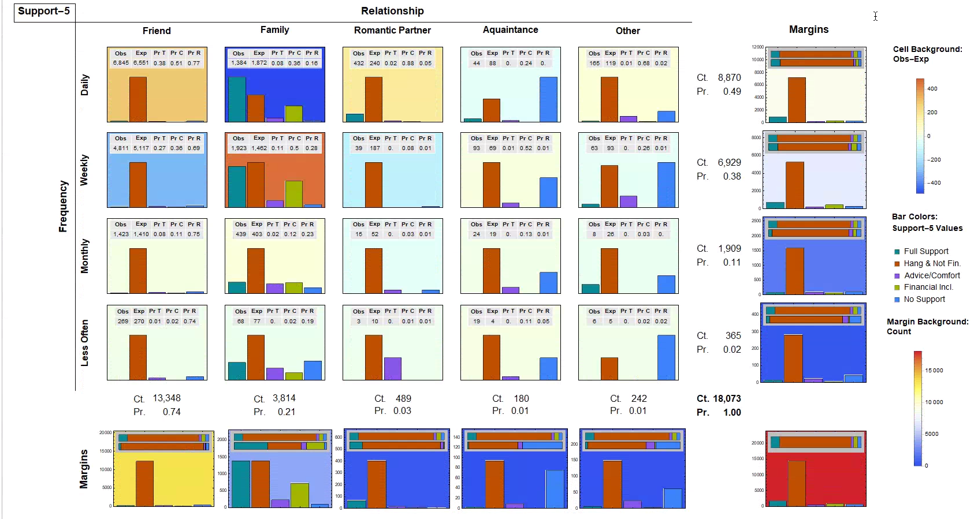

Slide 35
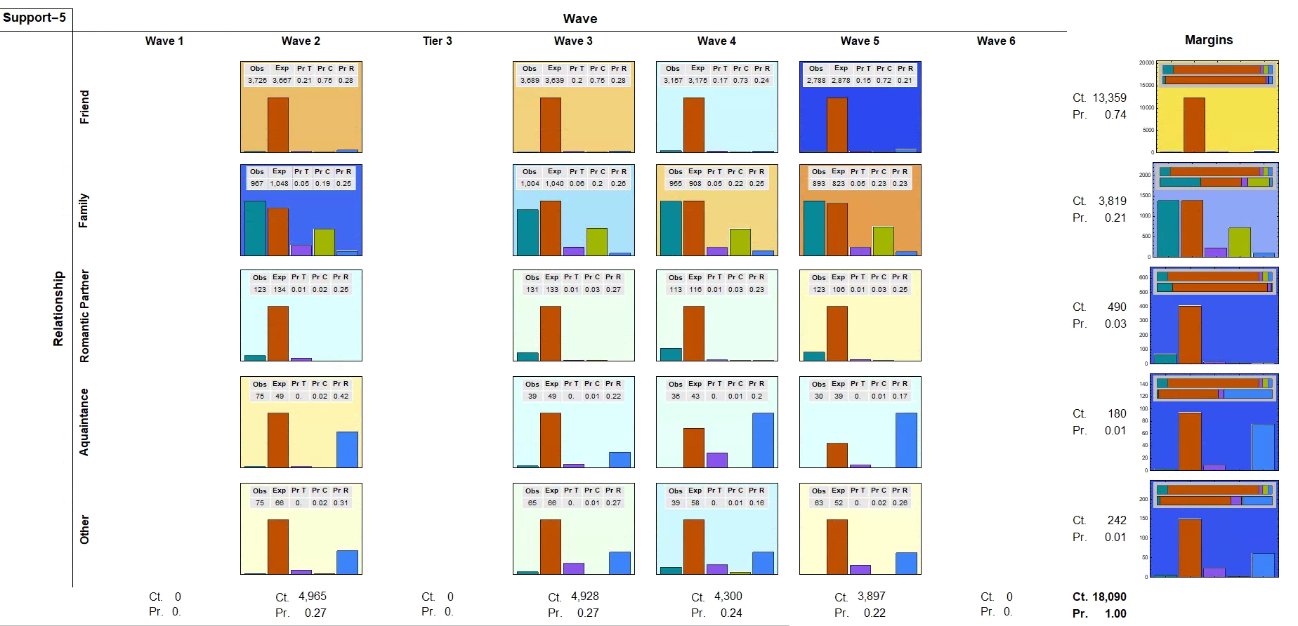

Slide 36
Conclusions
Indicators of strength are interdependent but not in a complex way
Very few three-way interactions
Students ego-networks mainly composed of:
Close ties
Frequently activated ties (e.g daily)
Friends
Recently formed ties (except for family)
People who provide companionship support
Tie strength profile differentiated by role relations
Family ties activated less frequently than friend ties
Support differentiated by role relations
Family provided the most variegated types of support
Support differentiation by role relations temporally stable

